Slide 1
Section 9.3 Review of Sample Means & Sample Proportions, and The Central Limit Theorem

Slide 2
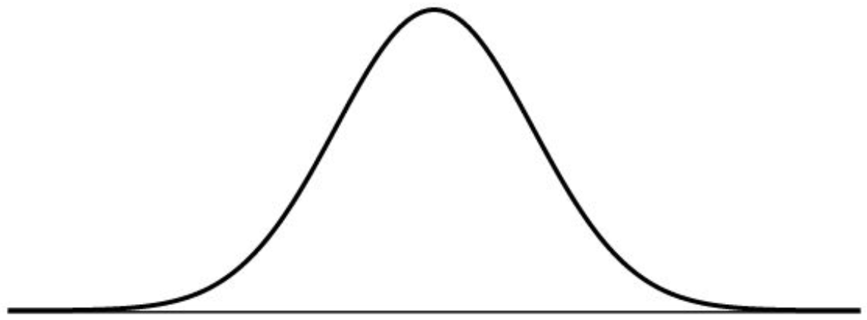
Does Sample Size Matter?
When the sample size is greater, the spread of the sampling distribution becomes smaller
When we take samples of size 16 and create a sample distribution of $\overline{x}$, the spread of the distribution will become smaller by 1/4
Suppose this is the population distribution of a random variable “X”
If you go UP or DOWN by 2 std dev. the percentage of the population in between would be 95%
This sampling distribution will have the same mean but smaller std dev
The percentage of sample means between 60 and 140 will be very close to 100%
This is b/c most of your sample means will be more concentrated towards the popul. mean

Slide 3
Suppose sample sizes are even bigger!! ie: n=100
The range of distribution of sample means will get even smaller!!
Key Concept: When the sample sizes increase, the range of possibilities of sample means gets smaller!!
The distribution of this sampling distribution of n=100 will have smaller “standard error” of 2
NOTE: the standard deviation in a sampling distribution is known as “STANDARD ERROR”
For this sampling distribution, getting a sample mean of 140 or 120 will be very close to zero!!

Slide 4
Suppose the SAT score for Canadian students is normally distributed with a mean of 1160 with a standard deviation of 200.
i) If you are to randomly select a Canadian student writing the SAT, what is the probability that the score is between 1300 to 1400?
ii) If we take a random sample of 50 Canadian students writing the SAT, what is the probability that the average score is between 1300 to 1400?
iii) If we take a random sample of 1000 Canadian students writing the SAT, what is the probability that the average score is between 1300 to 1400?

Slide 5
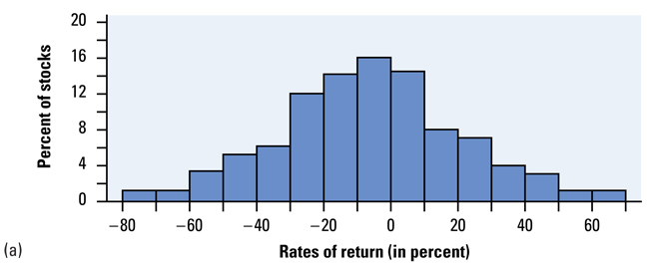
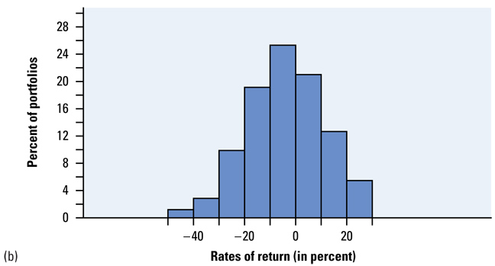
Stock Market: Is it Better to Diversify?
A basic principle of investing is that diversifying reduces risk
1987 NY. Stock Exchange, distribution of returns for all 1815 stocks
11% of all stocks had a loss of 40% or more
Extreme swings in stock prices, over 20% in single day
Diversifying in portfolios of 5 different stocks. Distribution of all portfolios returns (n= 5)
Only 1% of all portfolios had a loss of 40% or more
Note: Distribution of samples
have a smaller spread than the population

Slide 6
Ex: The chart on the next slide shows the rate of return for 3664 stocks in the US for the year 2020. Some Mutual Funds will pool their resources and diversify their investments into holding of 100 stocks. Use the start to answer the following questions:
a) What percentage of stocks have a positive rate of return?
b) What is the average rate of return for all 3664 stocks?
c) If you randomly select one of the stocks, what is the probability that it will have a positive rate of return between 10% to 20%
d) Suppose you are to purchase a mutual fund that is “randomly” diversified into 100 stock holdings, what is the probability that it will have a positive rate of return between 10% to 20%?
e) Which is better? To buy stocks or mutual funds?

Slide 7
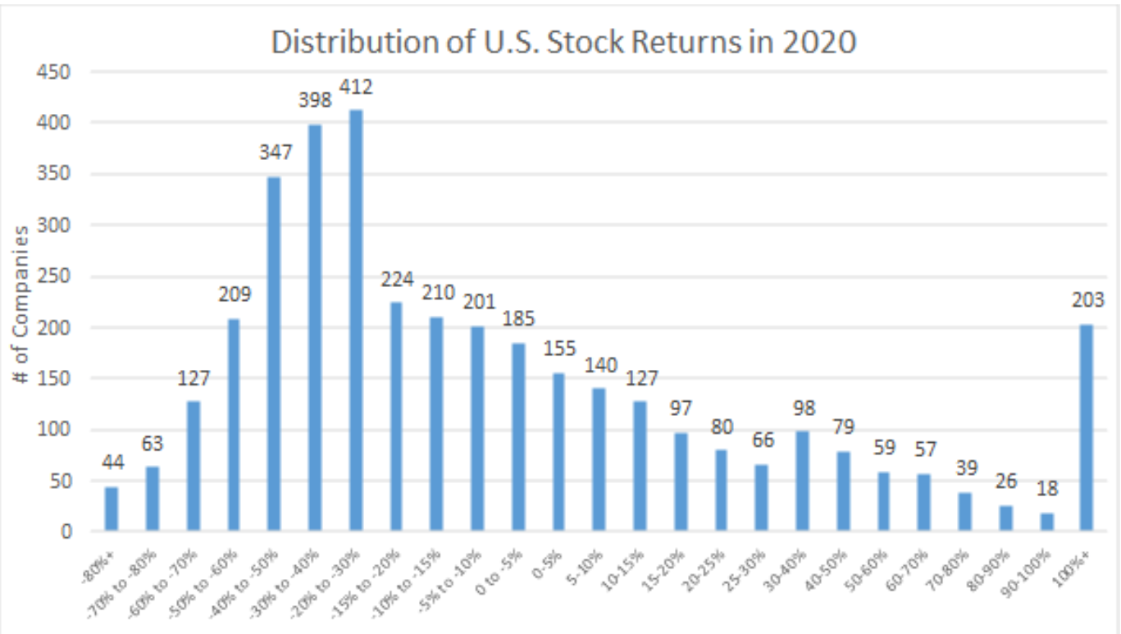

Slide 8
Mean and Standard Deviations of Sample Means
The mean of the sampling distribution of “ ” is equal to the true population mean µ
This is true only when the distribution contains all possible samples
The standard deviation of the sampling distribution of is smaller than the population SD (σ)
“n” is the sample size
If we want to reduce spread and variability in the sampling distribution of “ ” then increase the sample size
Formula for sample SD for any population size “N” & sample size “n”
This formula can only be used only if the population size is 10 times the sample size

Slide 9
Ex: In 2010, 9264 students wrote the Euclid contest with µ= 48.16 and SD of 17.212. The scores have a normal distribution
A). What is the probability that a single student randomly chosen from all those taking the test scores 80 or higher?
B) Now take an SRS of 10 students who took the test. What are the mean and standard deviation of the average (sample mean) score for the 10 students? Do your results depend on the fact that individual scores have a normal distribution?
The probability of choosing a single student at random whose
test score exceeds 21 is about 0.34
Results are independent of distribution shape

Slide 10
C) What is the probability that the mean score of these 10 students is 80.5 or higher?
It is very unlikely (less than 1% chance) that we would draw an SRS of 10 students whose average score exceeds 80.5

Slide 11
Ex: Suppose the weight of a chicken egg normally distributed with a mean weight of 60g and a standard deviation of 3g. Which probability below will be bigger? Explain:
a) Taking the average weight of 10 eggs and the probability that the weight is more than 65?
b) Taking the total weight of 10 eggs and the probability that the combined weight is more than 650g?

Slide 12
Activity 9B Penny Activity p597
The distribution of all pennies should be skewed right since there should be more new coins
If we take samples of 5 coins and did 15 simulations, the distribution will look approximately normal
If we repeat this experiment with a sample of 10 coins, the distribution will look even closer to a normal distribution
Goal: Despite the population distribution, the sampling distribution of any sample size “n” will always have a normal distribution. The bigger the sample size, the closer to a normal distribution

Slide 13
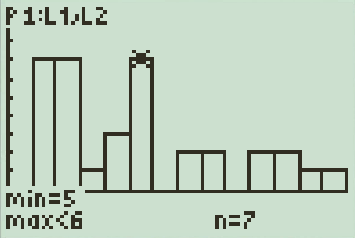
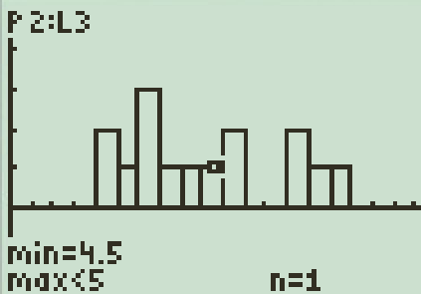
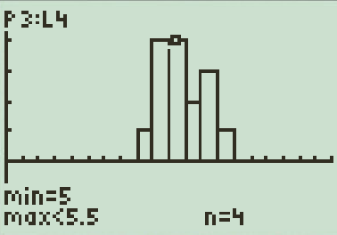
Central Limit Theorem:
When we take a SRS of size “n” from any population (skewed or normal) with a mean µ and finite standard deviation σ → the sampling distribution of the sample mean “ ” will be close to a Normal distribution:
The age distribution of 35 pennies. The population distribution is skewed left
Sample size: n= 5. 15 simulations. The distribution of “x” looks Normal
Sample size: n= 10. 15 simulations. The distribution of “x” looks more Normal

Slide 14
Homework:
TPS 9.24, 9.31, 9.33
TPS 9.35, 9.37, 9.38, 9.47

